Slide 1
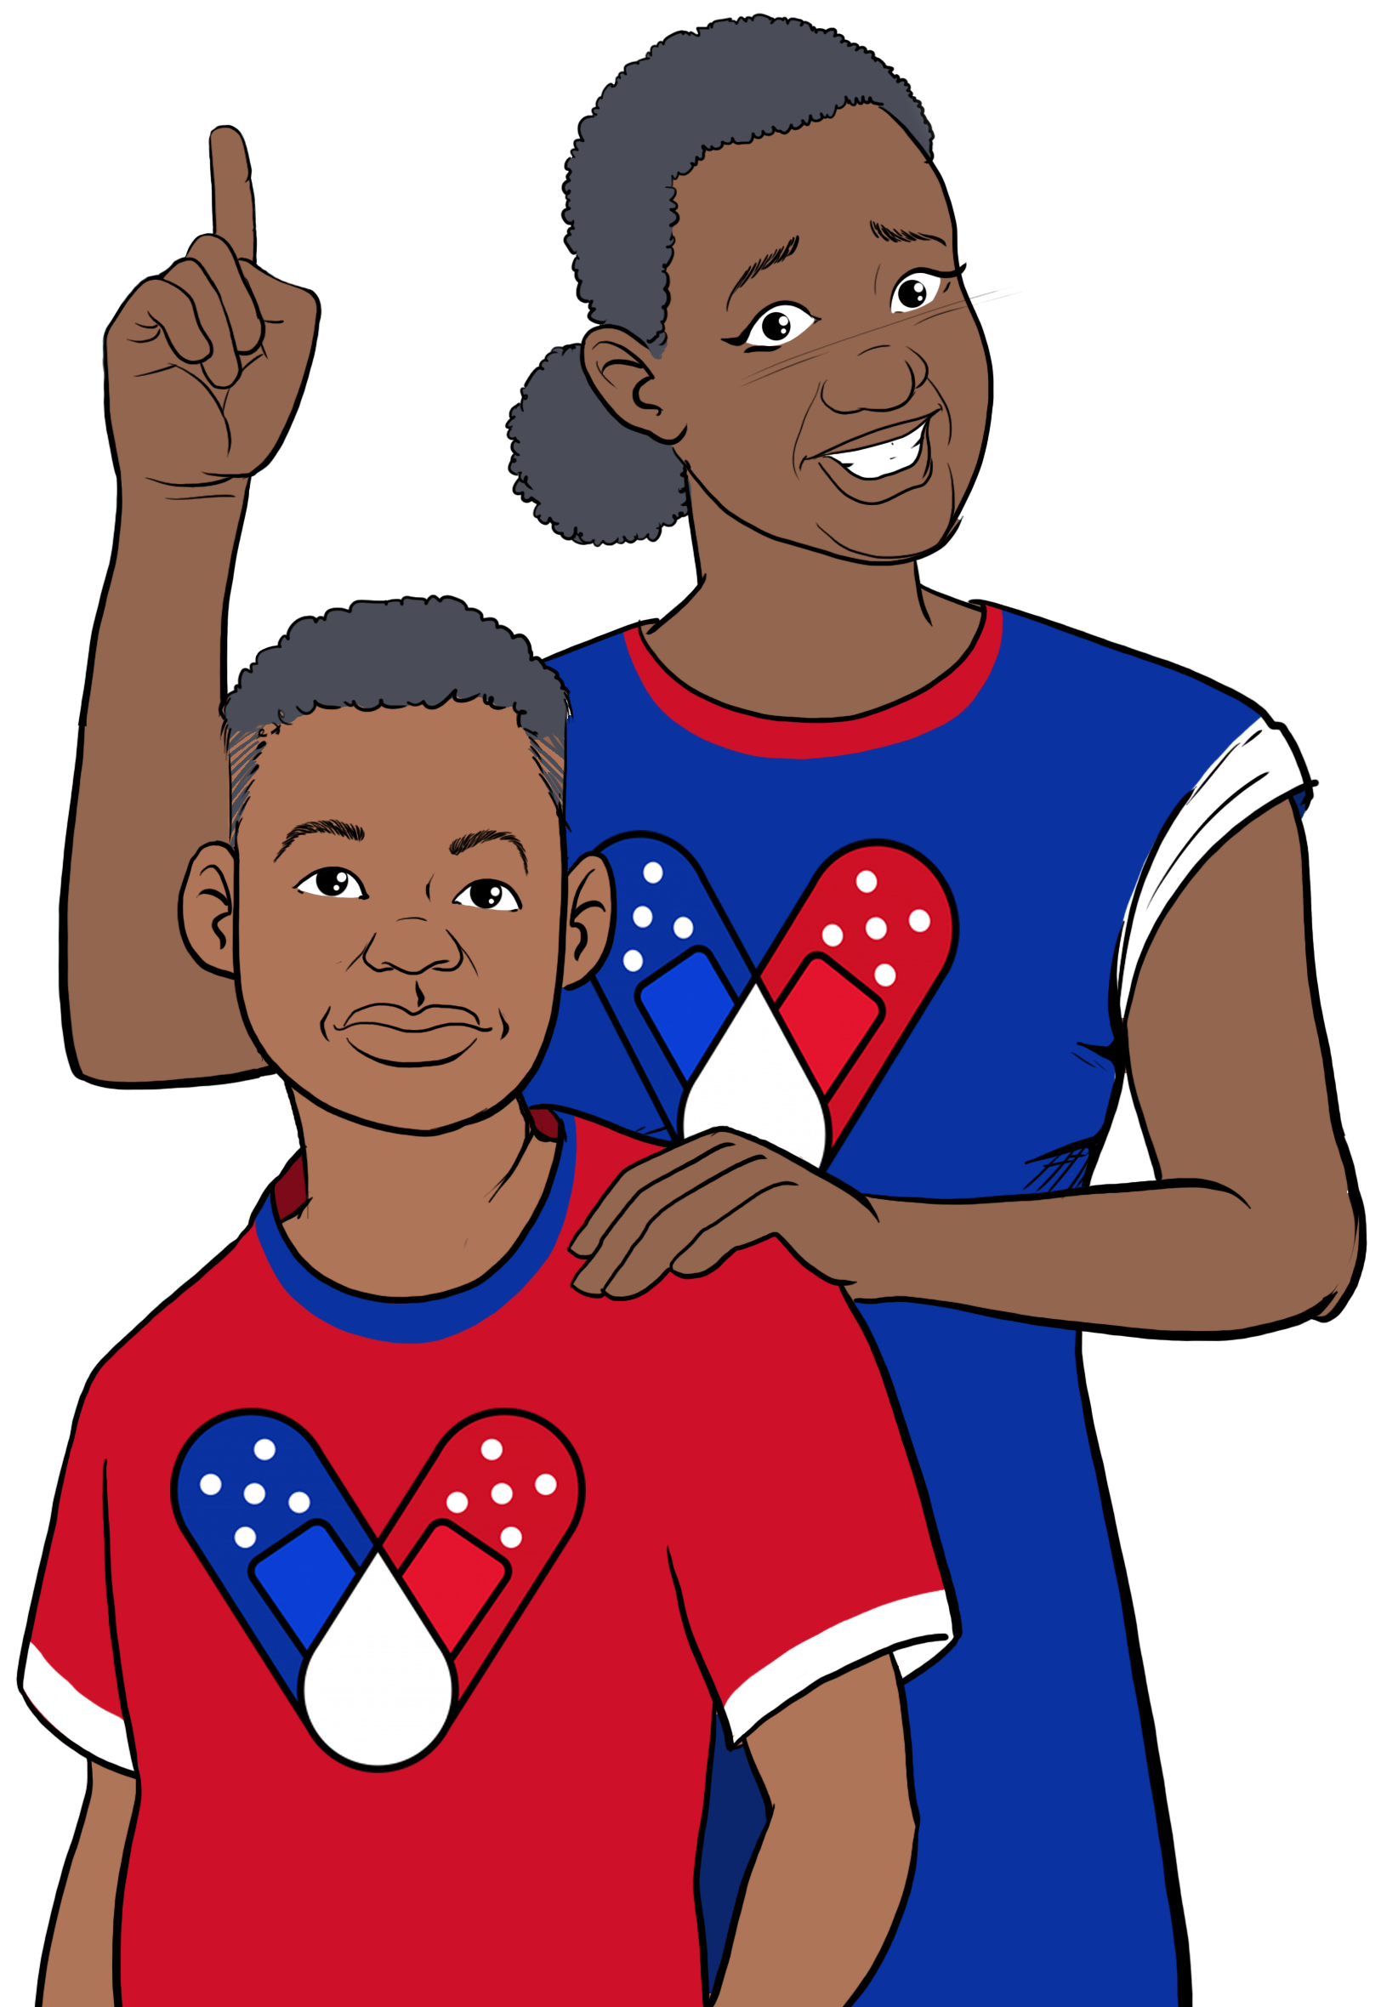
Why should we vaccinate children?
HOW CAN I GET MY CHILD A COVID-19 VACCINE?
Some children get very sick from coronavirus. COVID-19 is the 6th leading cause of death of children ages 5-11. Nearly 10,000 children have been hospitalized.
Most children don't become as sick as adults, but they can still spread it. COVID-19 vaccines prevent grandparents, younger siblings, and others from infection, hospitalization, or death from severe cases of the virus.
Getting kids vaccinated helps prevent outbreaks that cause school closures.
Contact your local health department to make an appointment or ask them where mobile vaccine clinics are located.
Contact your local community health center to make an appointment.
Ask your child's pediatrician if they offer COVID-19 vaccines.
Check with your local pharmacy. They will likely offer vaccines.
Speak with your child's school about getting a COVID-19 vaccine. They may offer in-school vaccine clinics.
In some places, parents are required to be present when their child is vaccinated. Look for after-hour and pop-up clinics to make it easier for working parents.
Is the vaccine safe for children?
Yes! In 4,500 children ages 6 months to 11 years, the vaccine was safe and effective in preventing severe cases of the virus in trials. Since December 2021 5.1 million children under 12 received at least one dose.
Risks from COVID-19 greatly outweigh any potential risks from the vaccine.
How do we keep children under five years old safe?
FOR MORE INFORMATION
Children and the COVID-19 Vaccine
Currently, there is not an approved COVID-19 vaccine for children under 5 years old. But you can protect children from being infected and spreading the virus to others.
Visit Centers for Disease Control and Prevention:
www.cdc.gov/coronavirus/2019-ncov/index.html
Ensure all household members aged 5+ are vaccinated.
Breastfeeding moms can get vaccinated to help pass antibodies to their baby.
Encourage indoor masking wearing and social distancing especially among the unvaccinated.
Wash hands.
Look for updates on whether a vaccine will become available for young children.
For answers to Frequently Asked Questions, visit Migrant Clinicians Network (MCN): https://bit.ly/3ki1xAI
GET VACCINATED!
Wear a mask
Social distancing
Wash your hands
Updated: March 22, 2022
COVID-19 Vaccine Awareness Campaign

Slide 2
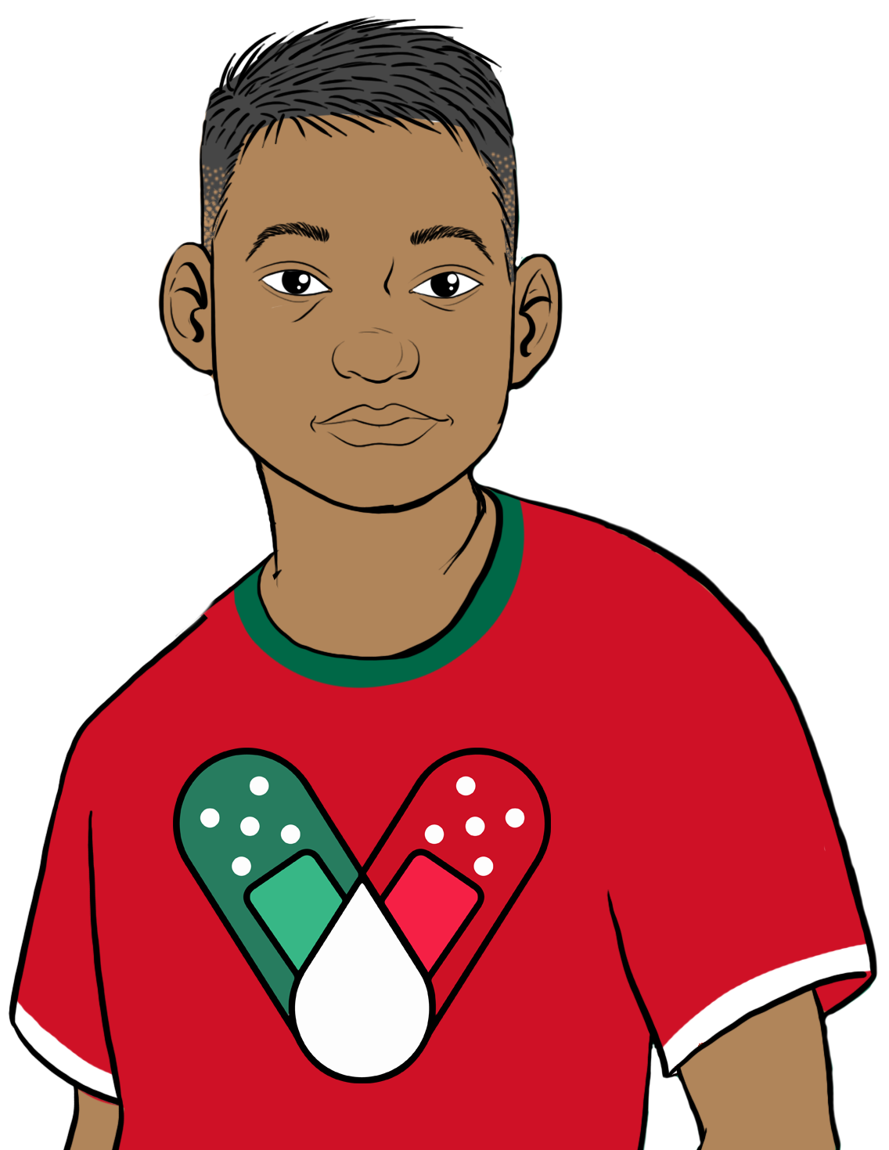
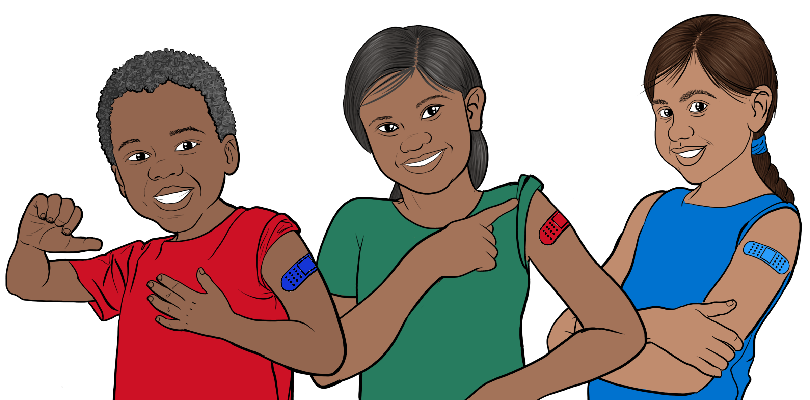
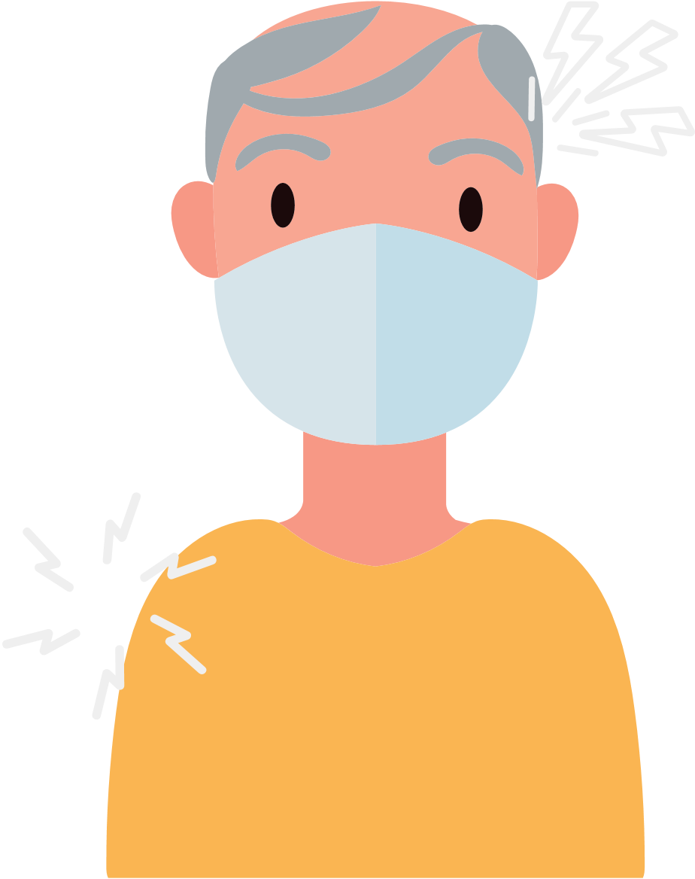
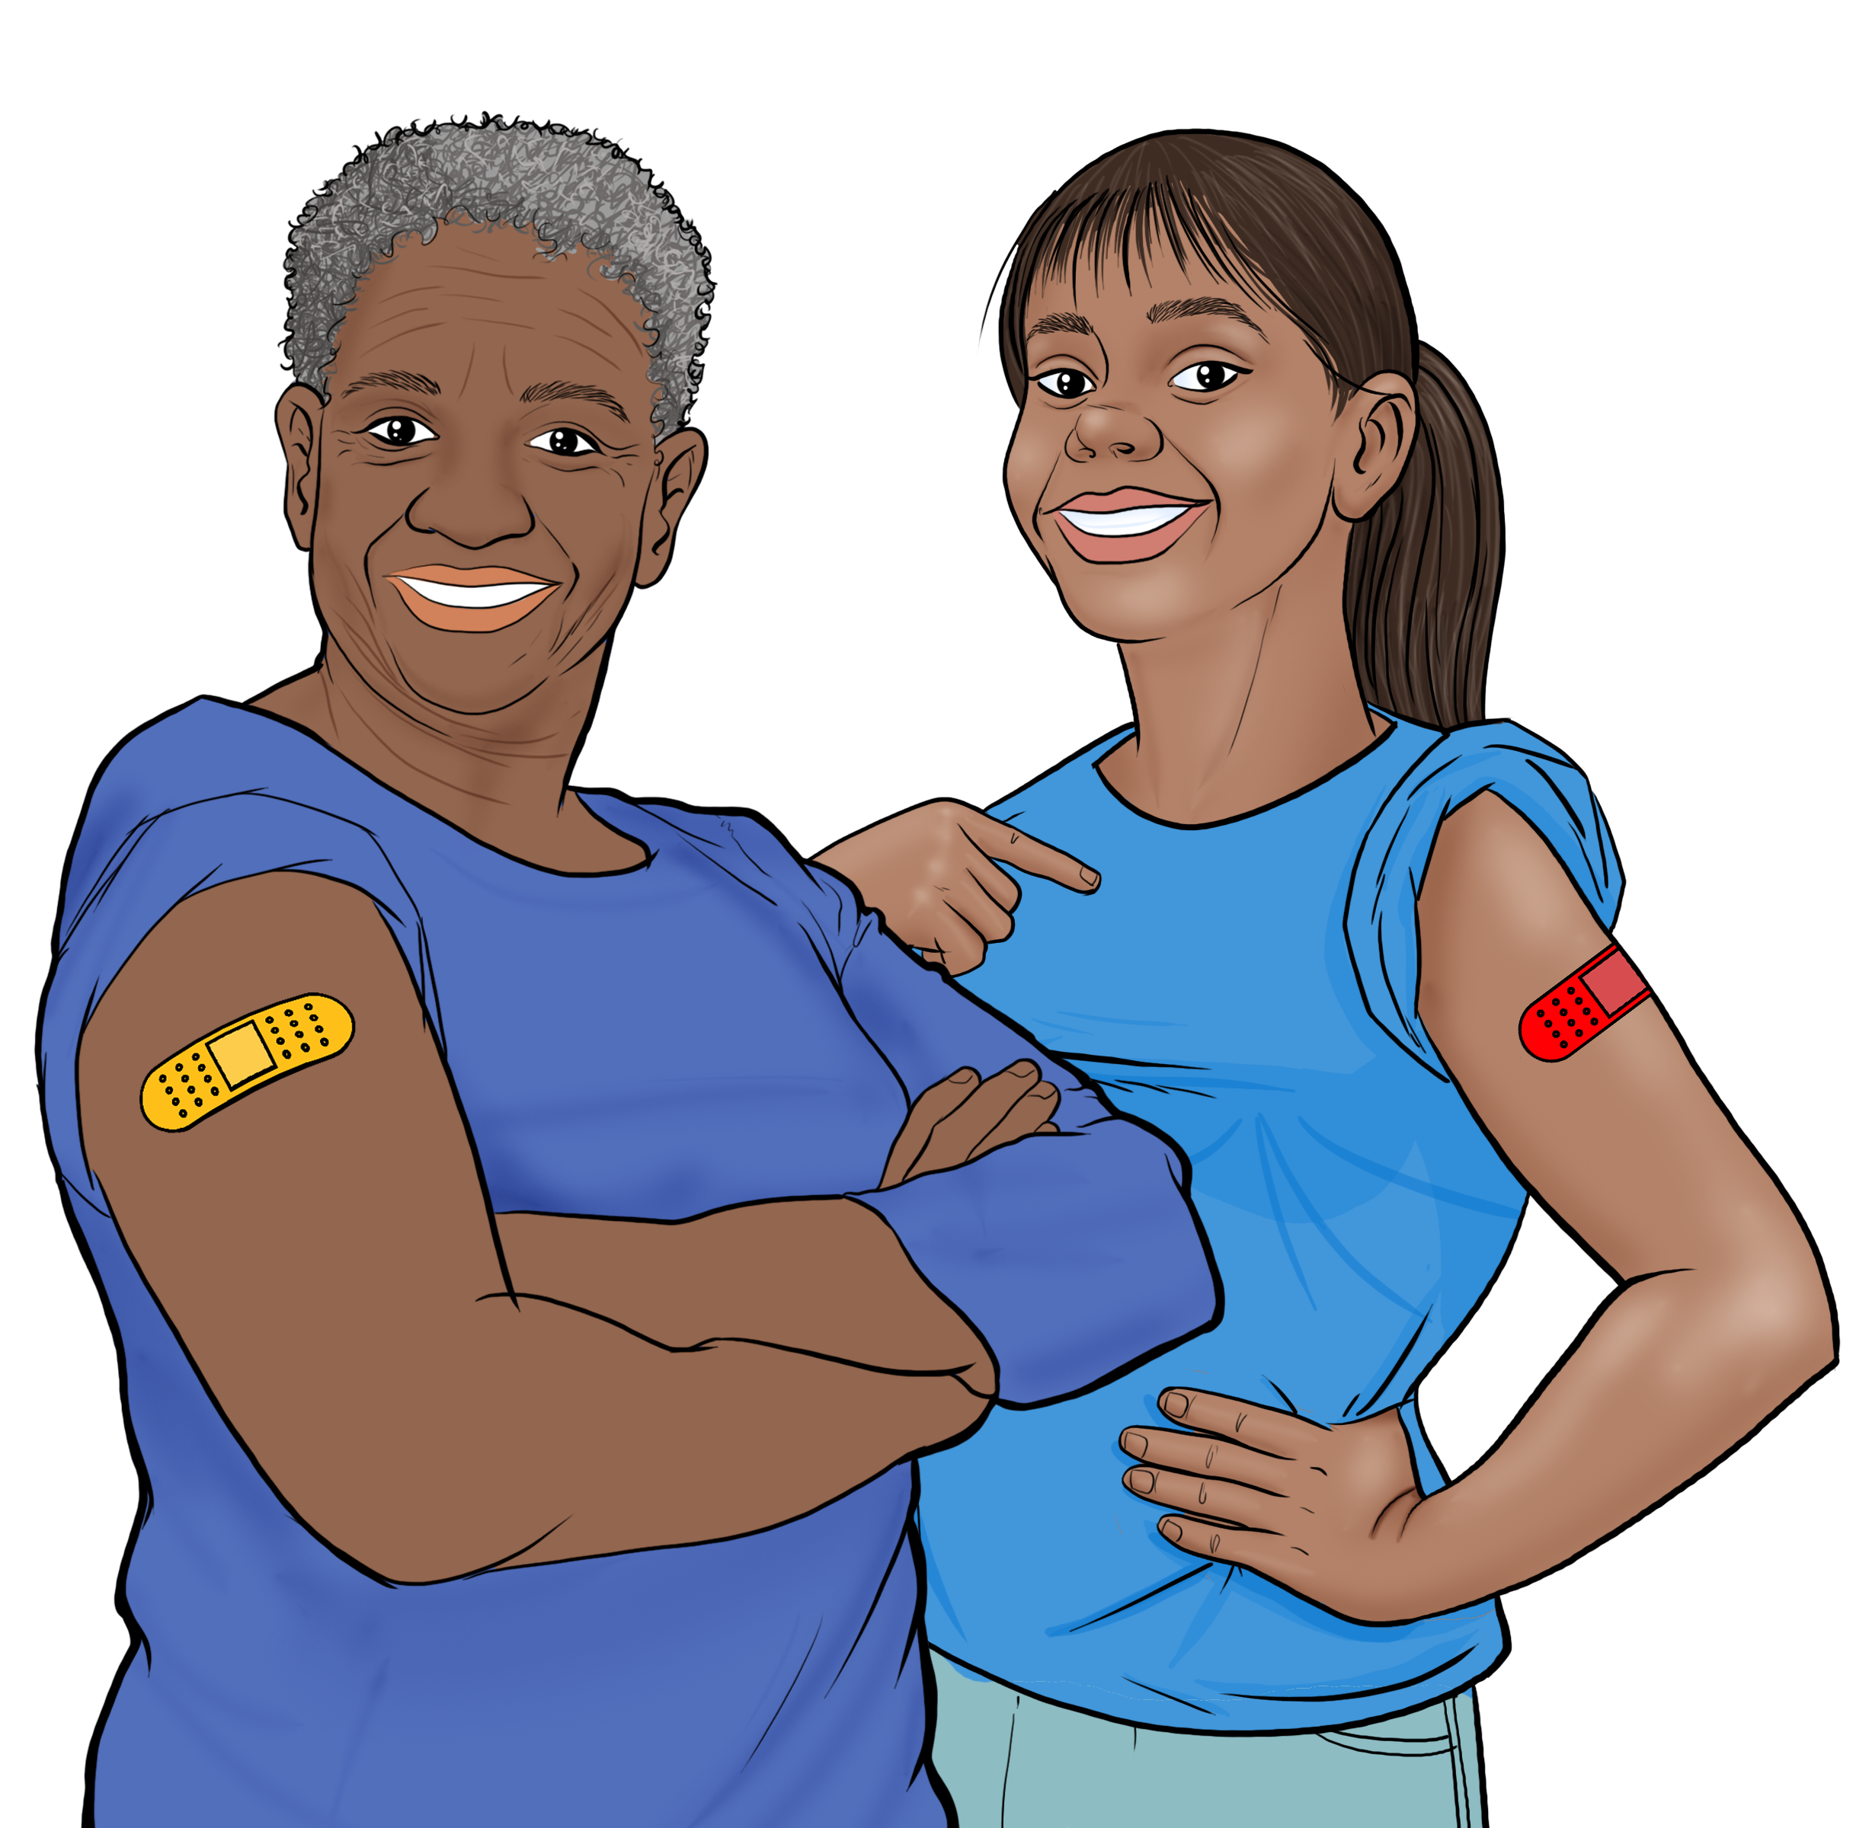
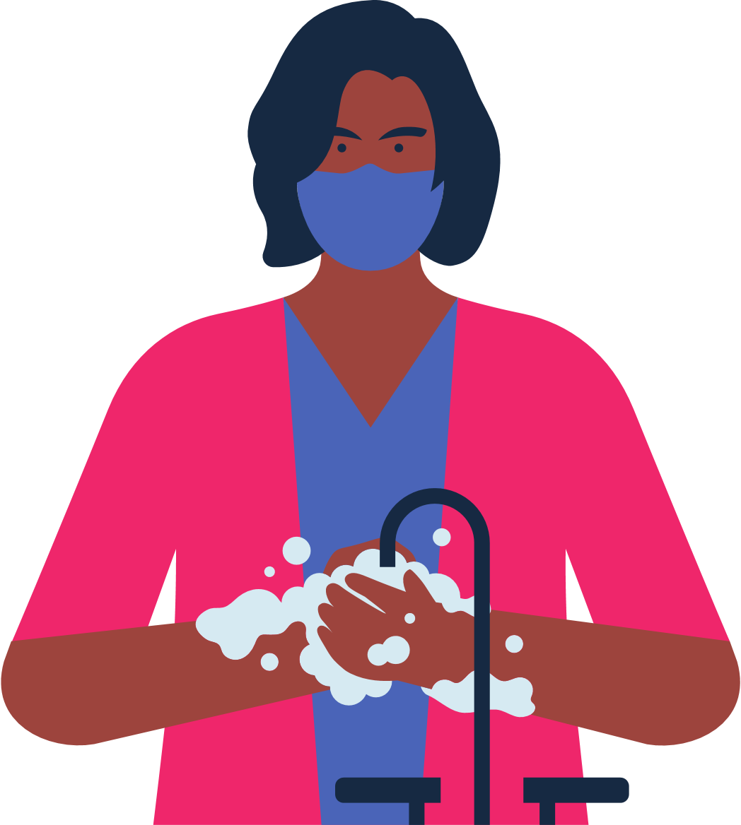
COVID-19 VACCINES
FOR CHILDREN
WHAT TO EXPECT AFTER CHILDREN ARE VACCINATED?
Children 5+: 2 doses, 3 weeks apart, but for boys 12-17: 2 doses, 8 weeks apart.*
Children 12-17: a booster is given 5 months after the second dose.
Immunocompromised children 5-11: a booster is given 28 days after the second dose.
BENEFITS OF VACCINATION
It is important for children to get vaccinated, even if they've had COVID-19.
It is completely FREE and does NOT require any form of identification.
Vaccination protects children and their families from becoming seriously ill and being hospitalized.
Vaccination decreases the number of new, severe, and deadly COVID-19 cases in your community.
Vaccination protects hospitals and clinicians from being overwhelmed with severely ill COVID-19 patients.
The more vaccinated individuals in our community, the less we need to worry about new variants.
Children can return to normal activities sooner if more people get vaccinated.
HOW TO PROTECT YOUR CHILDREN
Get vaccinated and get your children who are 5 and older vaccinated.
Wear a mask when indoors even when you are up to date on your vaccines.
If your child is up to date on their vaccination and is exposed to COVID-19, the child does not need to quarantine. Get them tested 5-7 days after exposure.
The COVID-19 vaccine is safe and effective for children.
After vaccination kids may experience: arm pain, headache, fever, or chills.
For
women:
They feel better a few days after the injection.
Kids are considered fully vaccinated two weeks after their final dose.
RISKS FOR UNVACCINATED
For women of any age who are pregnant, breastfeeding, or trying to get pregnant, vaccines are critical for keeping moms and their babies healthy.
For women and teens between 18-60 years old, we recommend getting Pfizer or Moderna.
Higher risk of COVID-19 infection.
Higher risk of serious infection, hospitalization, and death.
Higher risk of developing long-term symptoms of COVID-19 if infected.
Higher risk of being exposed to new forms of the virus that are more contagious and dangerous.
Continue to wear a mask, wash your hands, and maintain social distance.
Getting vaccinated helps protects kids and others from COVID-19!
*The CDC recommends this altered schedule to reduce the very small risk of myocarditis among adolescent boys.

