Slide 1
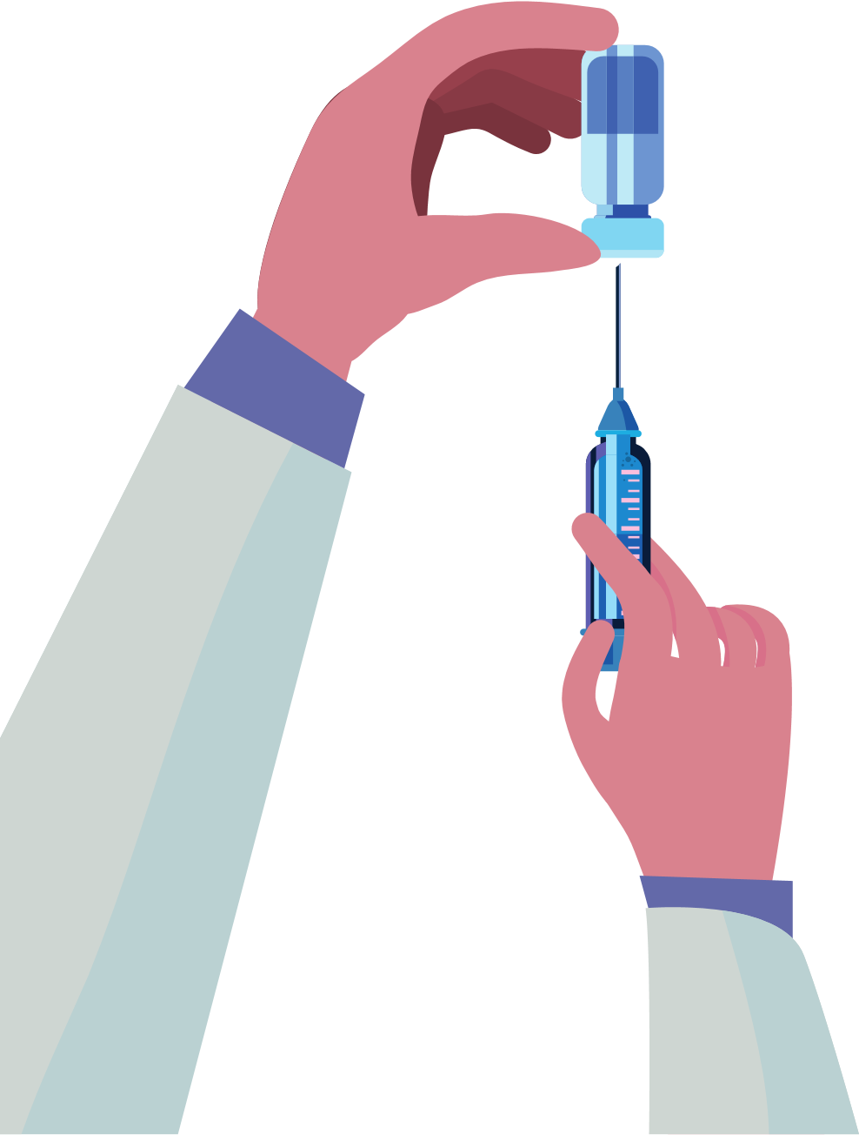
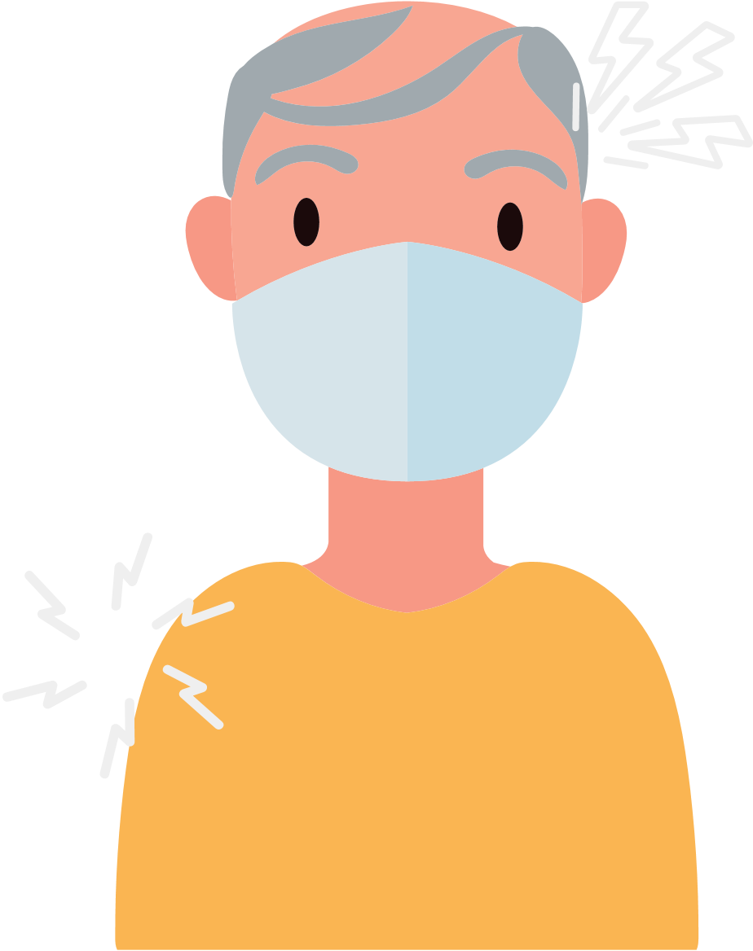
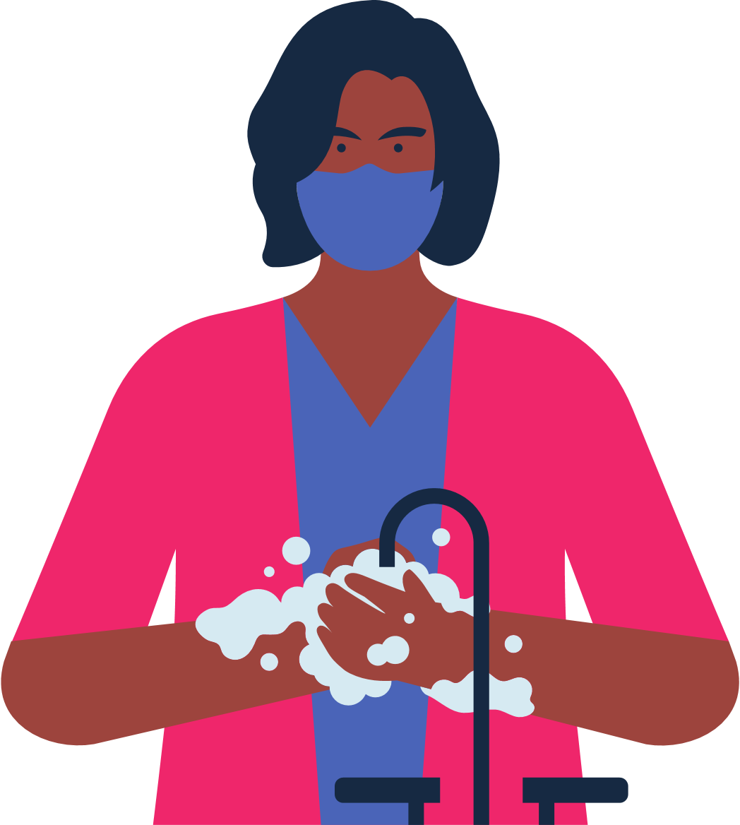
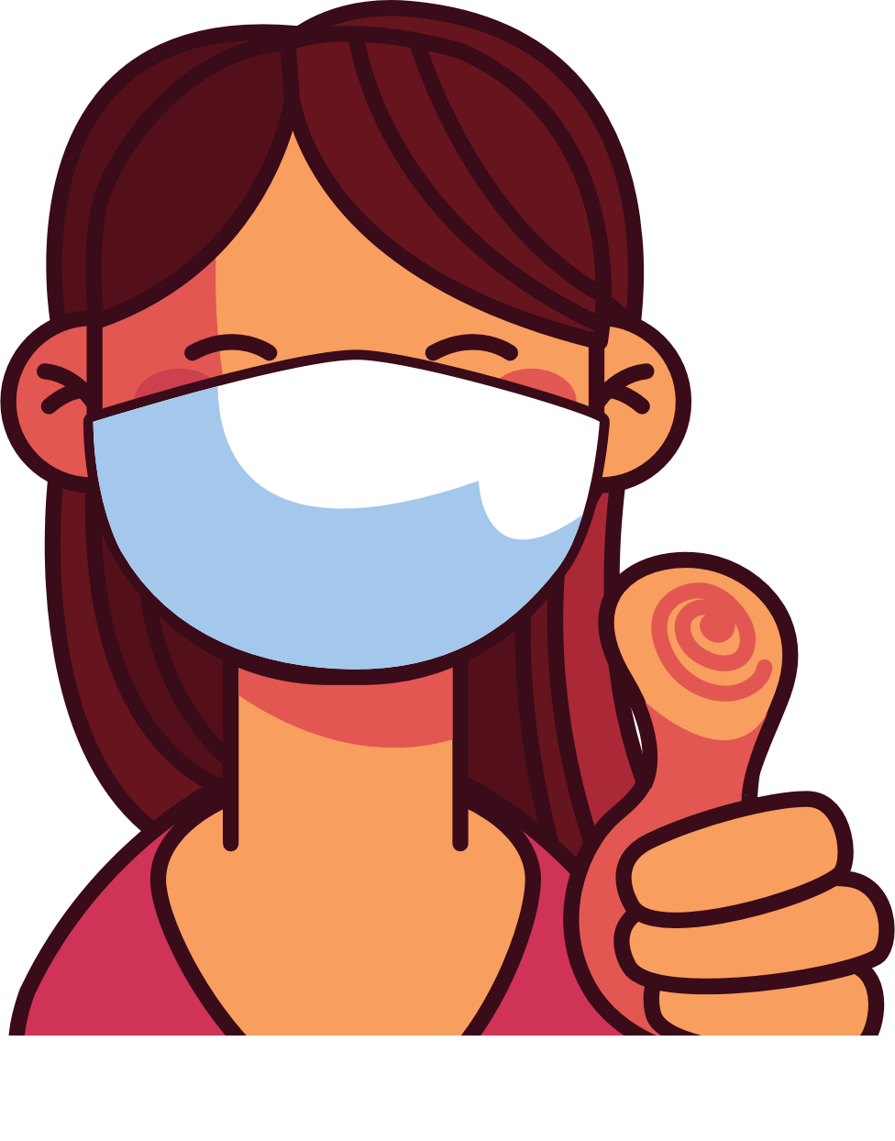
What to Expect When Getting the COVID-19 Vaccine
Even if you’ve had COVID-19, it is important to get the vaccine.
It's free for most everyone, including immigrants. No ID is required to get the vaccine.
There are several COVID-19 vaccines. Some require a 2nd dose. All are safe and effective.
You may have a sore arm, headache, fever or chills after receiving the vaccine.
You will start to feel better after a couple of days.
It takes several weeks before the vaccine protects you.
Insert State COVID-19 Logo Here
Upload State Resource Link Here
Upload Phone Numbers Here
Continue to wear a mask, wash your hands, and maintain your distance.
Make an appointment when it’s your turn.
Congratulations, you did your part in keeping yourself and others safe!
UPLOAD YOUR ORGANIZATION LOGO HERE

