Slide 1
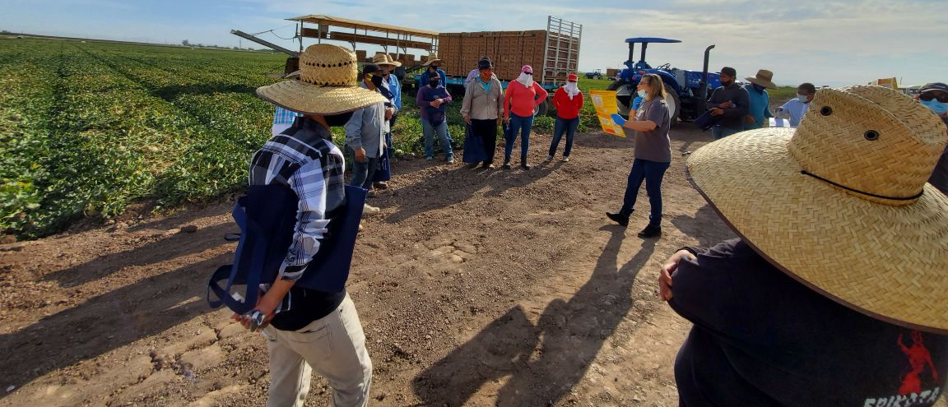
Protect Agricultural Workers from COVID-19 through Testing and Post-Test Support
Campesinos sin fronteras

Slide 2
Have agricultural workers already arrived at the farm?
YES
NO

Slide 3
Testing upon arrival and prior to exposure to current work crew is recommended. Farm owners can contact local community health centers or health departments to inquire about programs and assistance in testing and results management. Continue to question 3 for more on setting up testing parameters.
Continue

Slide 4
Have agricultural workers been exposed to someone, either at work or in congregate housing, that has tested positive for COVID-19?
“Exposure” is defined as within 6 feet for more than 15 minutes to someone who had tested positive to COVID-19. The exposure window must occur within the ten days prior to the positive COVID-19 test, meaning, if a worker tested positive but hadn’t been on the job for two weeks, her/his coworkers would not require a test.
As of August 24, 2020, the CDC does not recommend testing after exposure unless the local jurisdiction requests it. In the light of ongoing severe outbreaks of COVID-19 and deaths at farms and packing houses across the US, and the increased vulnerability and health inequities that most agricultural workers face, MCN strongly recommends testing after exposure, in contrast to the CDC’s present recommendation, to protect agricultural worker health, to prevent community spread, and to ensure farm owners can continue operations with a healthy workforce.
YES
NO

Slide 5
At this time, MCN does not recommend testing for agricultural workers who have already arrived at the farm and who have no known exposures to a COVID-19 positive person.

Slide 6
Is testing available that will provide results within 48 to 72 hours?
Due to delays, COVID-19 test results in some areas are unable to be returned within 48 to 72 hours.
YES
NO

Slide 7
MCN recommends connecting with your local community health center, health department, and/or agricultural worker advocacy organizations to secure resources and support to prepare for and conduct agricultural worker testing.
Continue

Slide 8
Test results with more than a 48- to 72-hour turnaround will result in lengthy quarantining that is unfeasible for most farm operations. All communities deserve access to timely accurate testing. Contact your local health authorities and government representatives to encourage the acquisition of improved COVID-19 resources.

Slide 9
Is isolation housing available?
If an agricultural worker tests positive for COVID-19, he/she must isolate until: at least 10 days from onset of symptoms has passed AND 24 hours without fever (without use of fever lowering medications) has passed AND improvement in respiratory symptoms is noted.
YES
NO

Slide 10
Housing must be separate from and have kitchen and bathroom facilities not shared with:
General/non-isolated workers/families.
Rule-out housing for COVID-19 symptomatic workers awaiting test results.
Quarantine housing for COVID-19 exposed workers.
Consider the number of agricultural workers that may have positive test results.
Continue

Slide 11
Providing housing is an essential part of testing. Local motels, closed universities, summer camps, retreat centers, and other local facilities may be available for rent. FEMA, health departments, and local community organizations may have funding available to help reduce the cost. After housing is made available, continue to question 5.
Continue

Slide 12
Is quarantine housing available for asymptomatic workers who have been exposed to COVID-19 and have initially tested negative?
COVID-19-exposed workers require 14-day quarantine housing even if initial test results come back negative, as they are at high risk of developing the infection over those 14 days.
As essential workers, some states have permitted exposed but asymptomatic agricultural workers to work while in quarantine as long as they are not in contact with any unexposed workers, either in their housing or at work. Testing these workers early in the quarantine period will remove those who test positive and decrease ongoing exposure to others. Any agricultural worker in quarantine who becomes symptomatic must be immediately removed from quarantine and retested. While awaiting test results, they must be housed separately from COVID –19-exposed, COVID –19-positive, and unexposed workers.
YES
NO

Slide 13
Housing must be separate from and have kitchen/ bathroom facilities not shared with the other categories of workers, as described in question 4.
Continue

Slide 14
See question 4 for resources. After housing is secured, continue to question 6.
Continue

Slide 15
Is rule-out housing available for COVID-19 symptomatic workers awaiting test results?
Rule-out housing needs to be available for those waiting for their test results. Make sure farmers are aware of the potential of needing to stay in rule-out housing, and need to plan food, toiletries, clothing, and other provisions accordingly.
YES
NO

Slide 16
Housing must be separate from and have kitchen/ bathroom facilities not shared with the other categories of workers, as described in question 4.
Continue

Slide 17
See question 4 for resources. After housing is secured, continue to question 7.
Continue

Slide 18
Are plans in place to provide food for COVID-19 positive workers/families in isolation?
For the duration of their isolation, agricultural workers with COVID-19 are not permitted to work. They can only live with others who are also COVID-19 positive. Plans for food acquisition and delivery must be drawn up. Rule-out housing, because of its short duration, does not require food provision.
YES
NO

Slide 19
Consider building relationships with organizations providing food support in the community, including local food banks. Once a food plan is in place, continue to question 8.
Continue

Slide 20
Are plans in place to check in on COVID-19-positive workers/families in isolation and to ensure access to medical care when needed?
Regular check-ins on workers in isolation are strongly encouraged.
YES
NO

Slide 21
Those providing the check-ins may be those delivering food. Proper protocol to ensure those checking in are not exposed (I.e., staying six feet away, with a mask on, outside if possible) should be in place. Workers should be provided with internet connection for telehealth appointments and with self-monitoring equipment such as automatic blood pressure cuffs, pulse oximeters and thermometers. Some or all of these medical supplies may be secured by working with community health centers, health departments, and community organizations. Once a check-in and medical care plan is in place, continue to question 9.
Continue

Slide 22
Is wage relief to be provided for COVID-19 positive workers who are in isolation or quarantine, who are ineligible to receive wage relief from federal or other programs?
MCN strongly encourages farms to provide wage relief to agricultural workers who test positive for COVID-19 and do not qualify for wage relief from federal or other programs.
YES
NO

Slide 23
Make sure your policy is written and communicated to agricultural workers in the language of the workers before testing.
Continue

Slide 24
Without a wage relief policy, agricultural workers will be reluctant to speak up about symptoms and/or avoid testing, which increases the risk of an outbreak on the farm and/or will discourage agricultural workers from seeking work at the farm in question which may result in a worker shortage. Develop a plan and communicate the plan to agricultural workers in the primary language of the agricultural worker. Once a policy is in place and ready to be communicated to workers, continue to question 10.
Continue

Slide 25
Is assurance for return-to-work provided?
YES
NO

Slide 26
Make sure your policy is written and communicated to agricultural workers in the language of the workers before testing.
Continue

Slide 27
Without a return-to-work policy, agricultural workers will be reluctant to speak up about symptoms and/or avoid testing, which increases the risk of an outbreak on the farm and/or will discourage agricultural workers from seeking work at the farm in question which may result in a worker shortage. Develop a plan and communicate the plan to agricultural workers in the primary language of the agricultural worker. Once a policy is in place and ready to be communicated to workers, continue to question 11.
Continue

Slide 28
Are plans in place to talk to agricultural workers about testing, provision of housing, food, wage relief, and other parts of this protocol?
Communication in the language of their choice, low- or no-literacy flyers, and culturally competent trainings can help workers understand a farm’s protocols to ensure buy-in and compliance.
YES
NO

Slide 29
You have concluded your preparation for testing.

Slide 30
MCN strongly recommends developing a partnership with the local community health center and/or agricultural worker advocates to prepare trainings and resources before testing begins.

